Slide 1
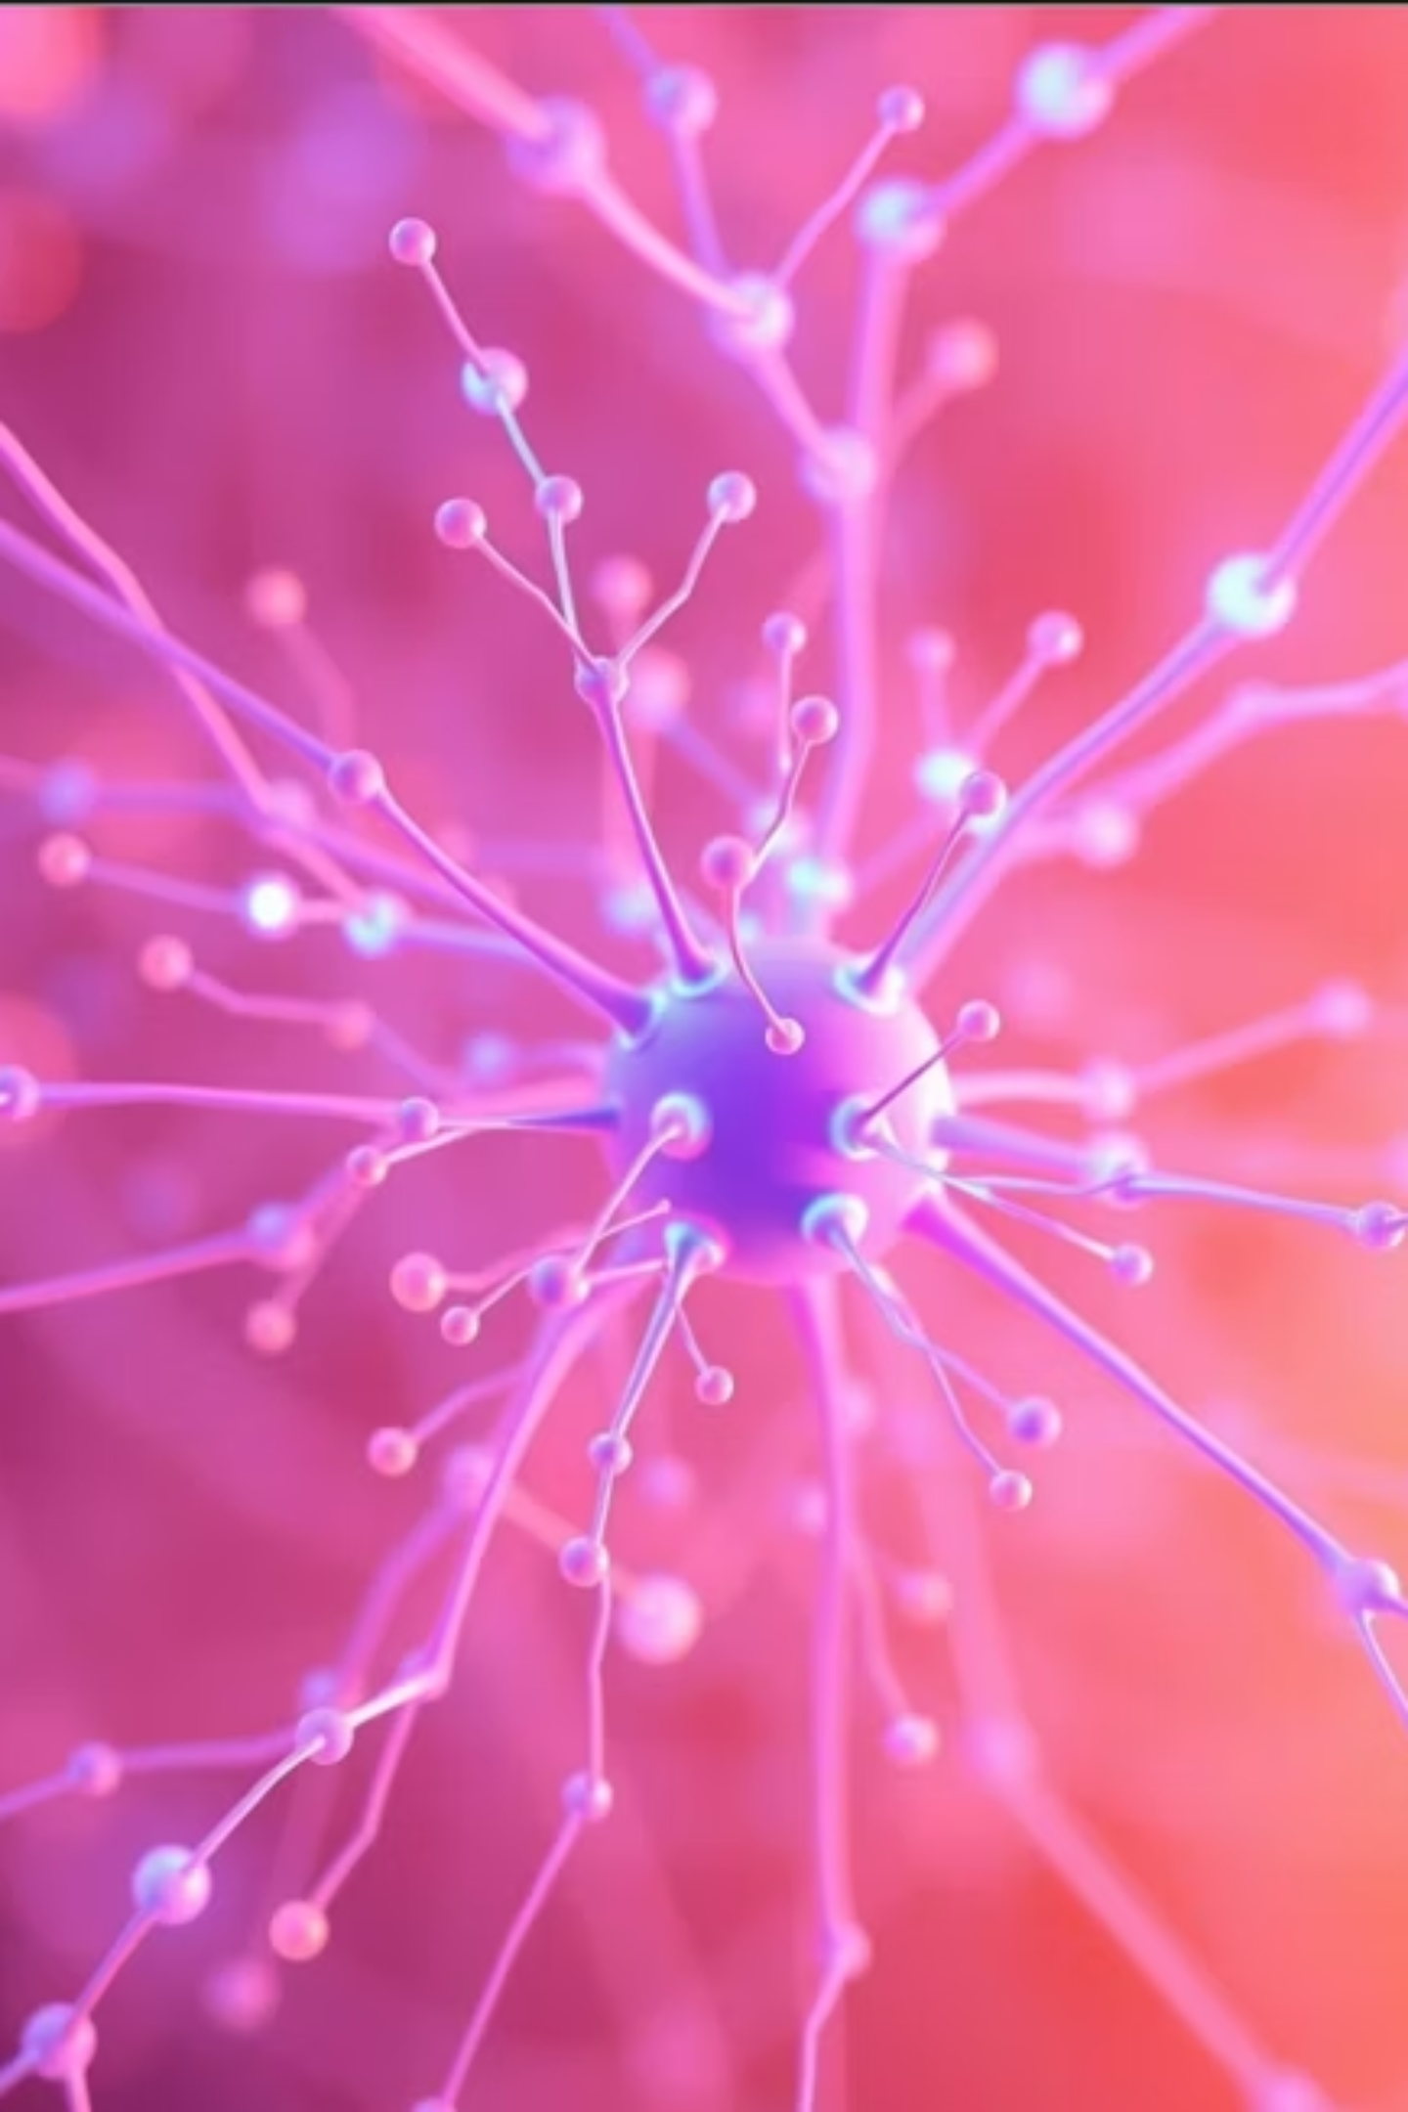
Latent Space Representation using AE & VAE
Explore how Autoencoders (AEs) and Variational Autoencoders (VAEs) learn compact data representations. We will visualize their latent spaces and compare reconstruction capabilities, concluding with latent vector arithmetic for generative insights.
Presented by Raga Manasa from GITAMW

Slide 2
Presentation Objectives
1
Build Autoencoders
Construct both Autoencoder and Variational Autoencoder models.
2
Visualize Latent Space
Map and visualize the learned latent representations.
3
Compare Reconstructions
Evaluate reconstruction quality from each model.
4
Perform Latent Arithmetic
Experiment with arithmetic operations on latent vectors.

Slide 3

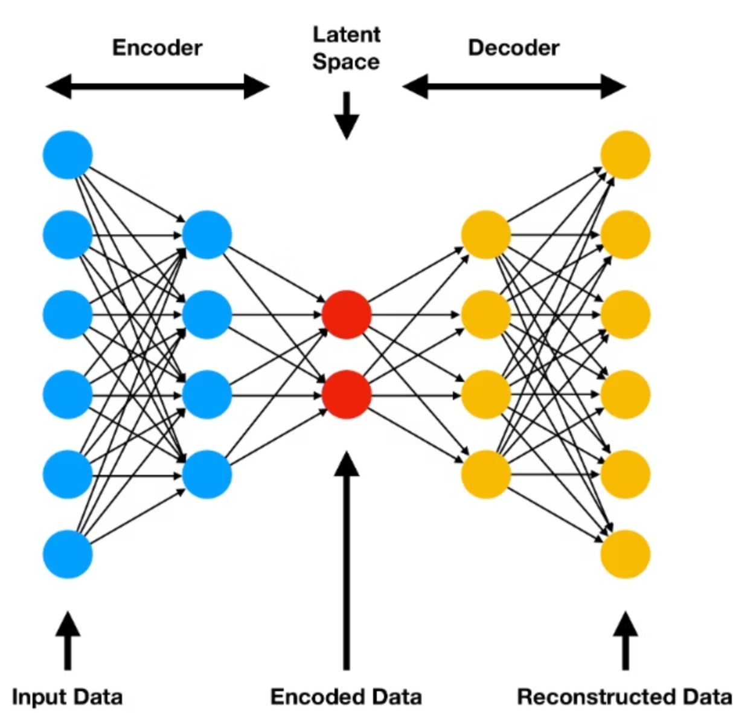
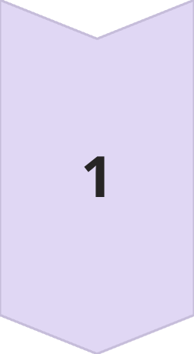
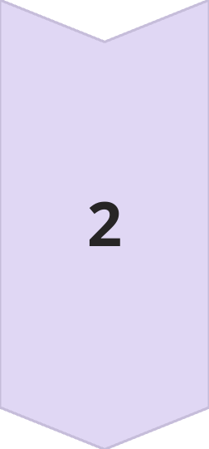
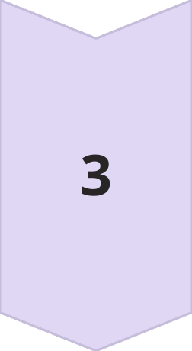
Autoencoder (AE) Architecture
Encoder Design
The encoder compresses input data into a lower-dimensional latent space. It uses convolutional layers with ReLU activations.
Decoder Design
The decoder reconstructs data from the latent space back to its original form. It employs transposed convolutional layers and sigmoid activation for output.
Loss Function
Mean Squared Error (MSE) measures the difference between original and reconstructed inputs. It guides the model's learning process.

Slide 4
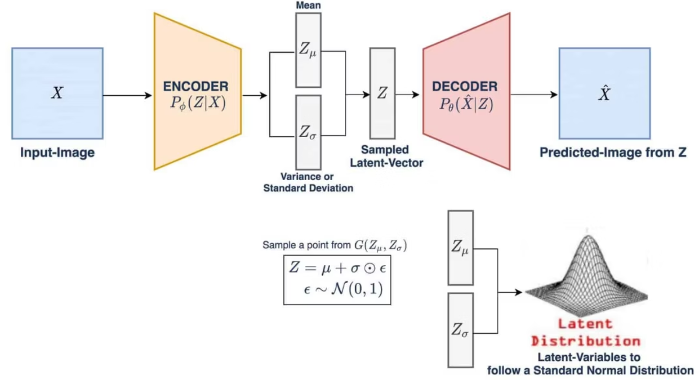
Variational Autoencoder (VAE) Architecture
Key Differences
VAEs map inputs to a distribution (mean μ and variance σ) in latent space. This contrasts with AE's fixed point representation.
KL Divergence
A loss component that regularizes the latent distribution. It ensures the learned distribution is close to a standard normal distribution.
Reparameterization Trick
This technique allows backpropagation through the sampling process. It enables training of the mean and variance parameters effectively.

Slide 5
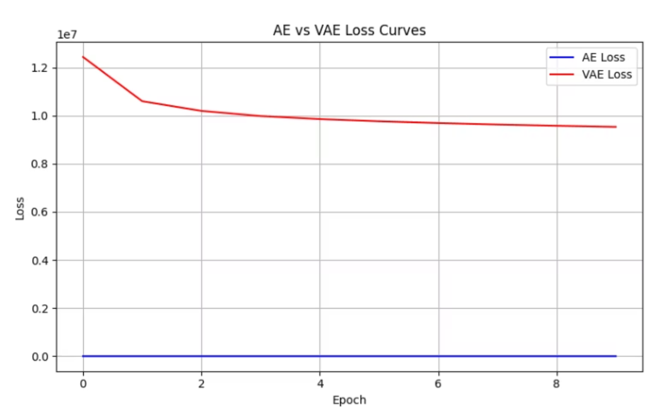
Training Loss Curves
The AE loss converges smoothly, indicating stable reconstruction learning. VAE loss shows higher initial values due to the added KL divergence term, but also converges effectively.

Slide 6
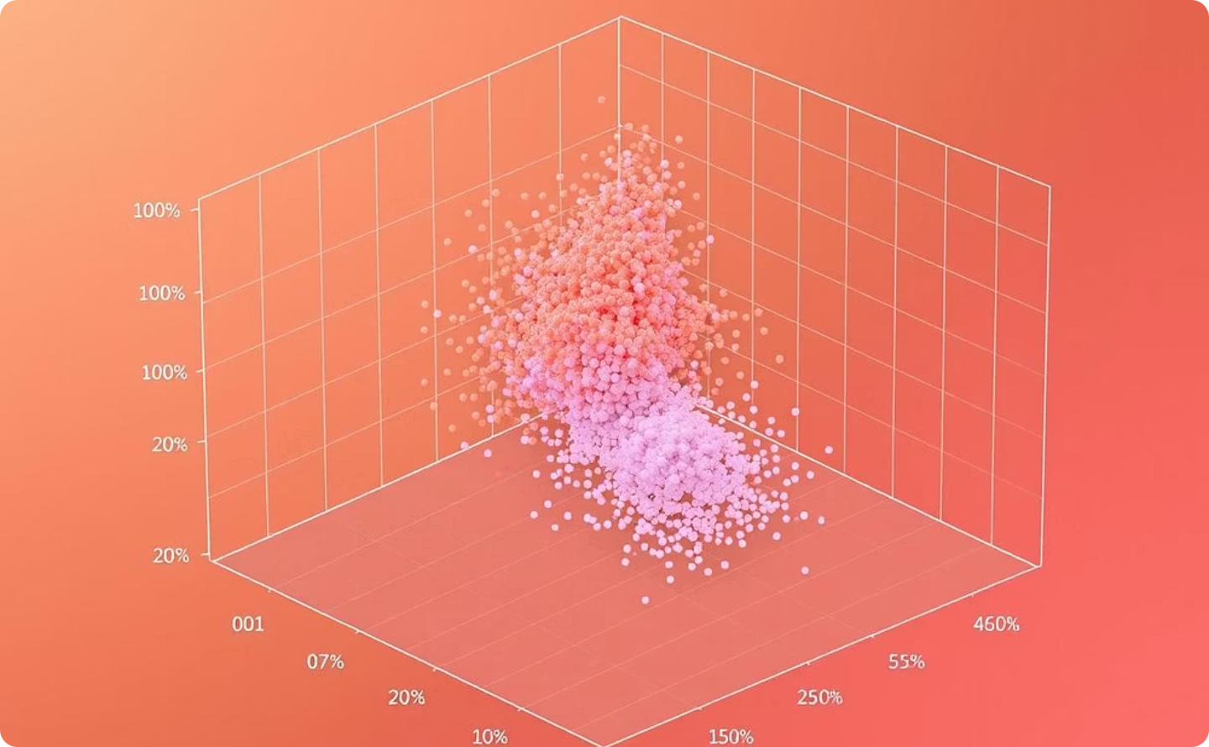
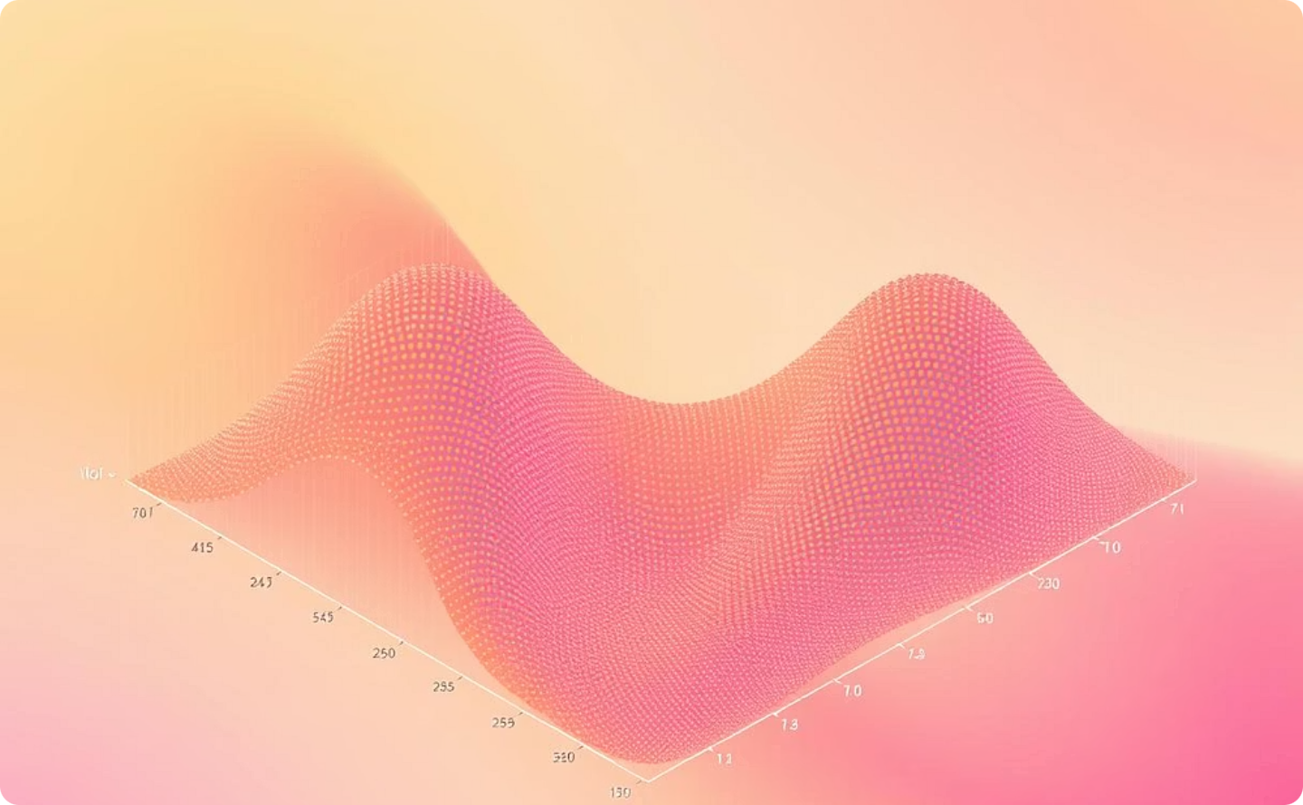
Latent Space Visualization
AE Latent Space
VAE Latent Space
PCA or t-SNE plots for AE often show dense, distinct clusters. This suggests good discrimination but limited generative continuity.
In VAEs, the latent space is typically more spread out and continuous. This facilitates smoother interpolations and diverse generation.

Slide 7
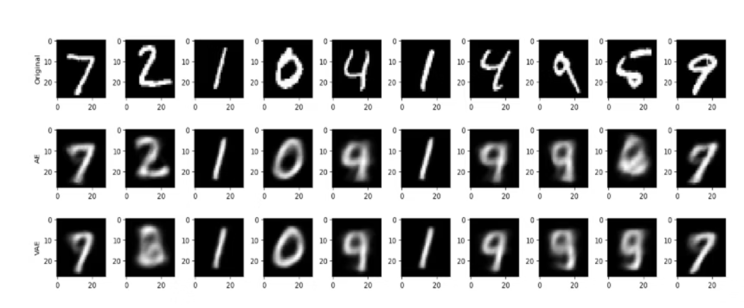
Reconstruction Results
AE reconstructions are often sharper but less diverse. VAE reconstructions are smoother and capture more global features, showcasing their generative capabilities.

Slide 8








Latent Vector Arithmetic & Comparative Analysis
Interpolation
VAE's Smoothness
Linear interpolation between two latent vectors generates smooth transitions. For instance, transforming a digit '3' into an '8'.
VAEs excel in producing visually consistent interpolations. This highlights the continuous nature of their learned latent space.
Insights Gained
Comparative Summary
Latent arithmetic reveals how models understand semantic relationships. VAEs are better suited for generative tasks due to their structured latent space.
AEs are great for compression and specific reconstruction. VAEs are superior for generating new, diverse, and realistic data samples.

Slide 9
Thank You

